Slide 1
ROCK PAPER SCISSOR LIZARD SPOCK
Sourabh kulkarni | FSJ0220A007

Slide 2

About The Project
RPSLS is just like Rock Paper & Scissors,each player(computer and player) has to choose any one variable Rock, Paper, Scissors, Lizard or Spock.The players then reveal their choice on the 4th prime, One Two Three Shoot. Players often use a rock gesture during the priming phase of the competition. If there is a tie on a throw, the players simply replay the point and point(+1) is given to the player whoever wins it.

Slide 3
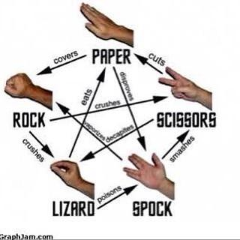
Game Rules
Scissors cuts Paper
Paper covers Rock
Rock crushes Lizard
Lizard poisons Spock
Spock smashes Scissors
Scissors decapitates Lizard
Lizard eats Paper
Paper disproves Spock
Spock vaporizes Rock
Rock crushes Scissors

Slide 4
Why This Project
Reason 1: Popular and most played game by all age group.
Reason 2: Time killer and creates competition environment.
Reason 3:Easy and simple to play.

Slide 5
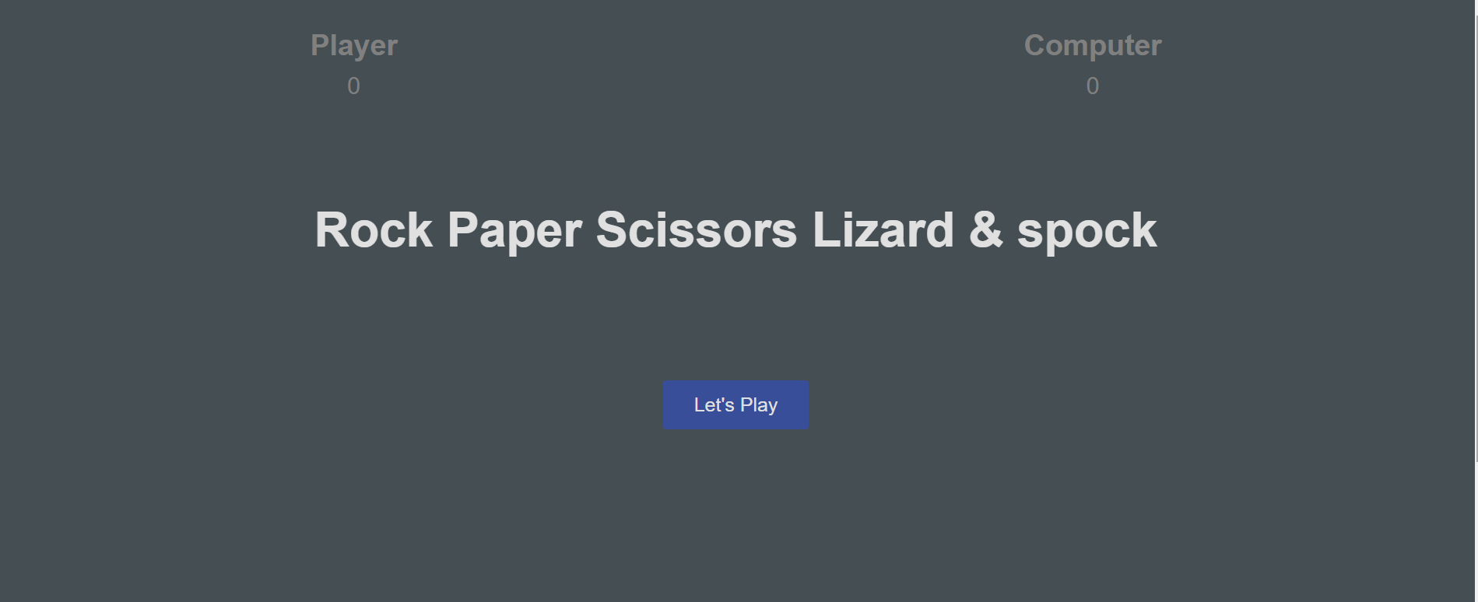
The Project

Slide 6
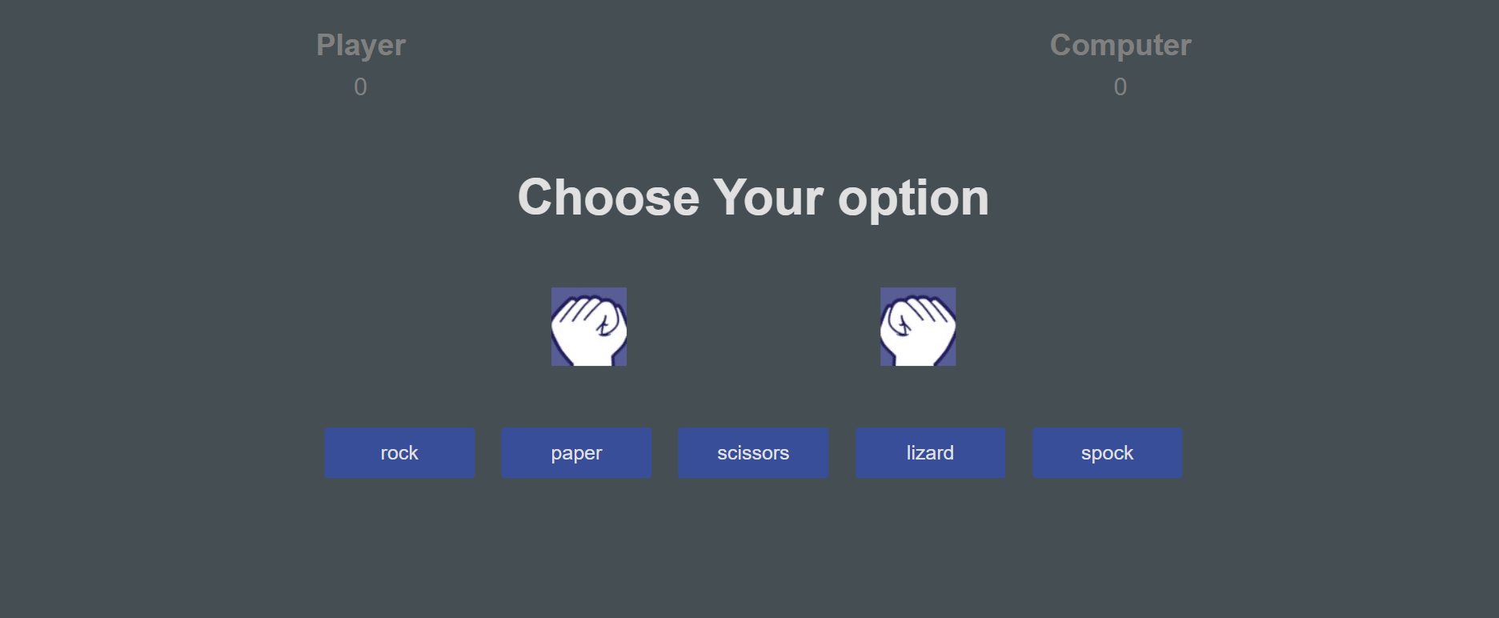
The Project

Slide 7
Concepts Used To Implement This Project
1. Concept 1: creating my html skeleton
2. Concept 2: styling the game
3. Concept 3: writing code using javascript
4. Concept 4:creating animations
5. Concept 5: launching game with github

Slide 8
The Challenges Faced
01
02
03
Challenge 1: Building logic for game became challenging for me.
Challenge 2: writing the code in javascript for my game was also a challenging part for me.
Challenge 3: TIME=>managing my time was a great challenge for me, i guess i managed it very well as the days went on.

Slide 9

Thank You

